Slide 1


3-D Vision and Perspective
A Foundation for Depth Perception and 3D Reconstruction

Slide 2


What is 3-D Vision?
Ability to perceive depth and 3-D structure
Humans: disparity, motion, perspective cues
Computers: interpret 2-D images for 3-D

Slide 3

Why Perspective Matters
Parallel lines converge at vanishing point
Objects appear smaller farther away
Key cue for depth in single images

Slide 4
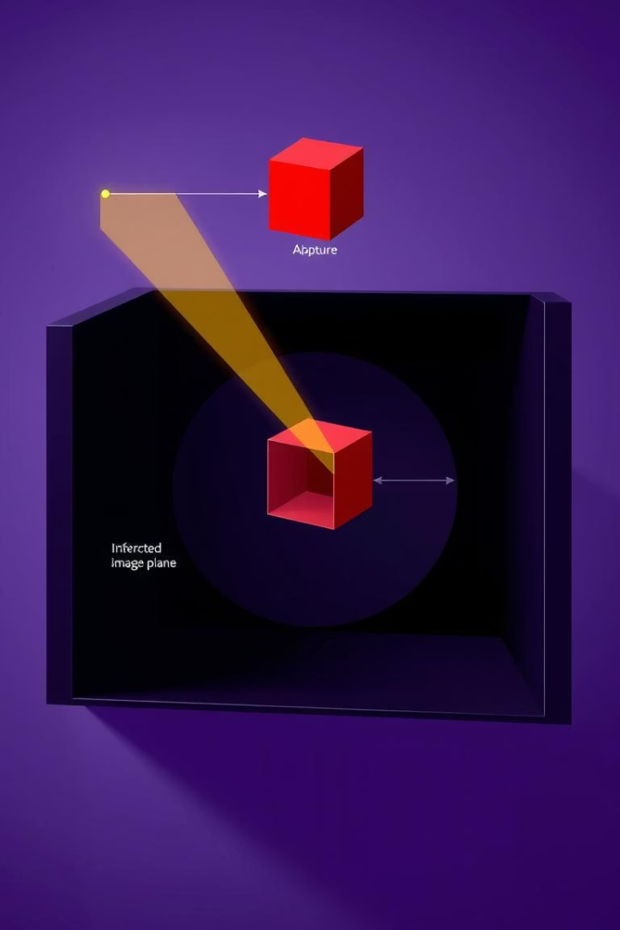



Perspective Projection
3-D point (X, Y, Z) mapped to 2-D (x, y)
Projection follows x = fX/Z, y = fY/Z
Based on pinhole camera model

Slide 5

Visual Illustration
Light rays create 2-D images from 3-D scenes
Vanishing point: where parallel lines meet

Slide 6

Applications of Perspective
Camera calibration for intrinsic parameters
3-D scene reconstruction
Augmented reality aligns virtual and real
Robotics spatial navigation

Slide 7




Leads Into...
Binocular stereopsis: depth from two views
Epipolar geometry: view constraints
Structure from motion: depth from movement

Slide 8
Summary
Perspective transforms flat images to 3-D data
Uses pinhole camera and projection equations
Foundation for stereo vision, AR, robotics

